Slide 1
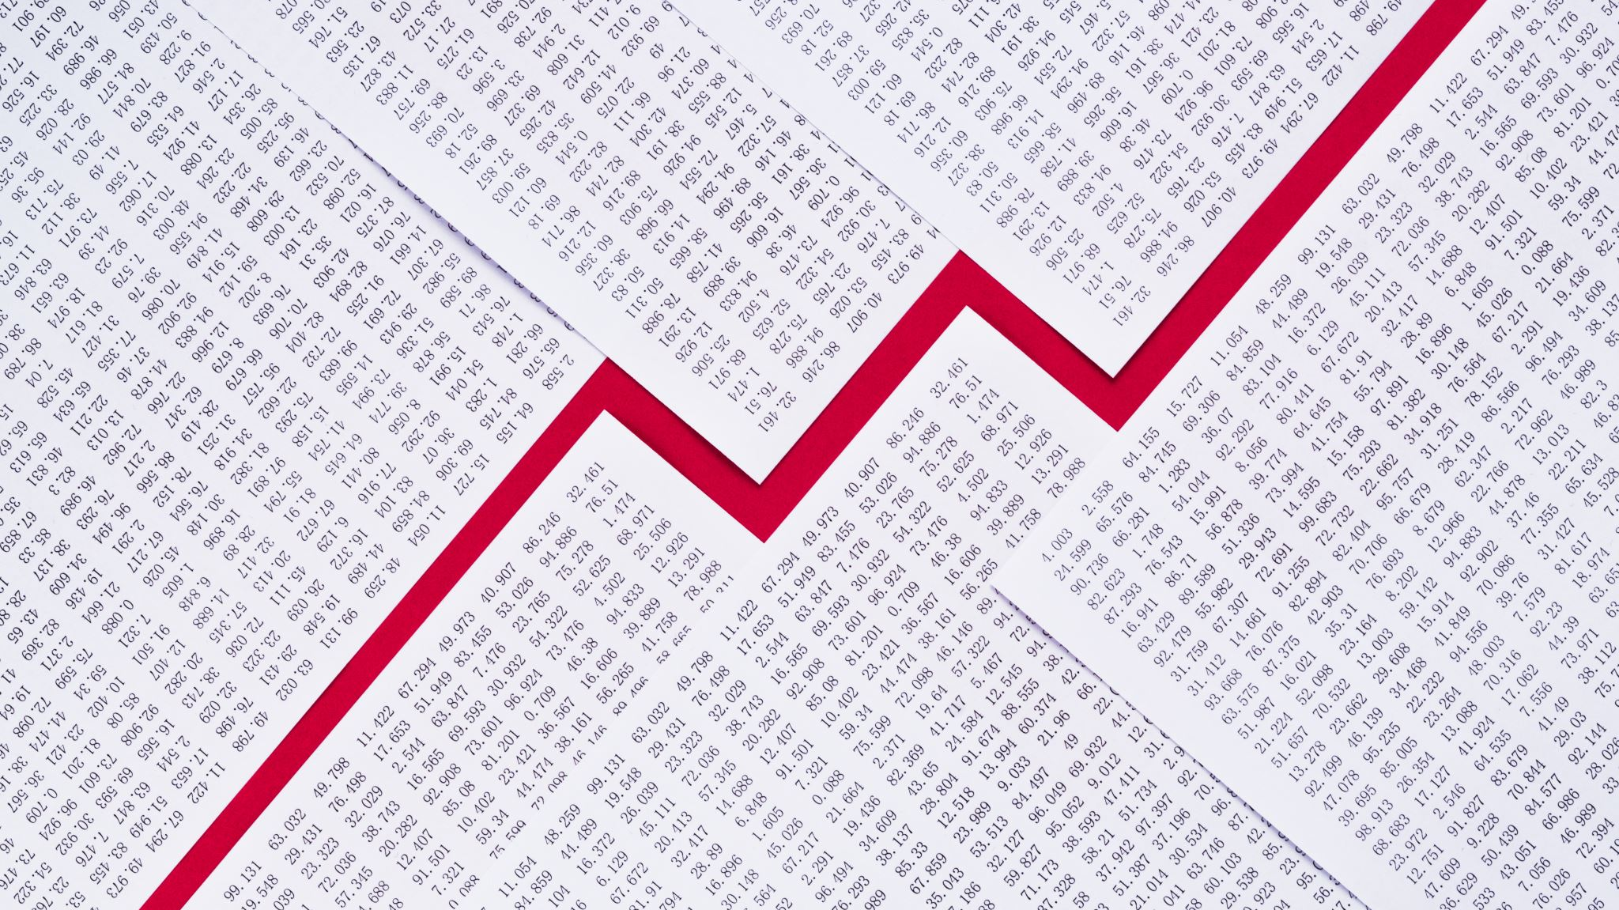
Exchange Rate Application
Project Proposal by Nils Berzins

Slide 2
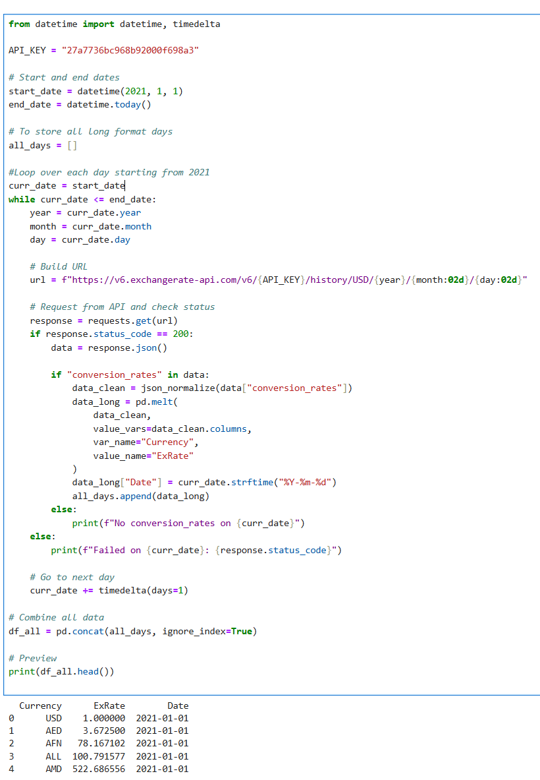
Data Collection Plan/Process
Data from ExchangeRate-API
1 request = 1 days exchange rate data
Returned JSON data therefore using pandas json_normalize.
256,211 obs in dataset between 2021-01-01 to today.
Data Collection Next Steps:
Parsing other Forex data sources and country borrowing rates data
Calculating new variables e.g. 10–30-day momentum, 30-day variance, etc.

Slide 3
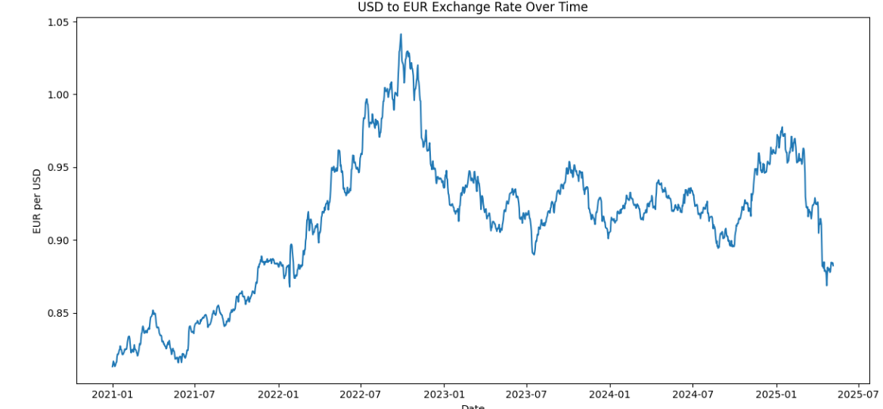
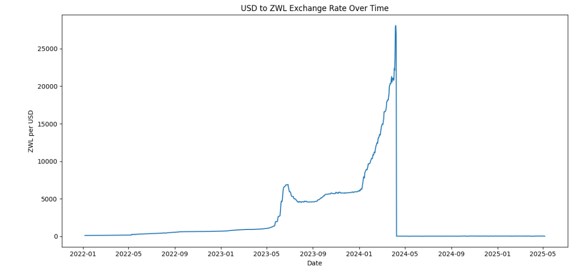
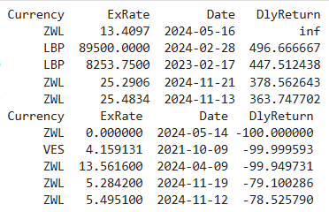
EDA
Well-managed API/Dataset
Null Counts:
Currency: 0
Exchange Rate: 0
Date: 0
Changes in World Currencies – Newly Retired/Adopted
ZWL → ZiG
Leading to a graphical collapse in the ex-rate.

Slide 4
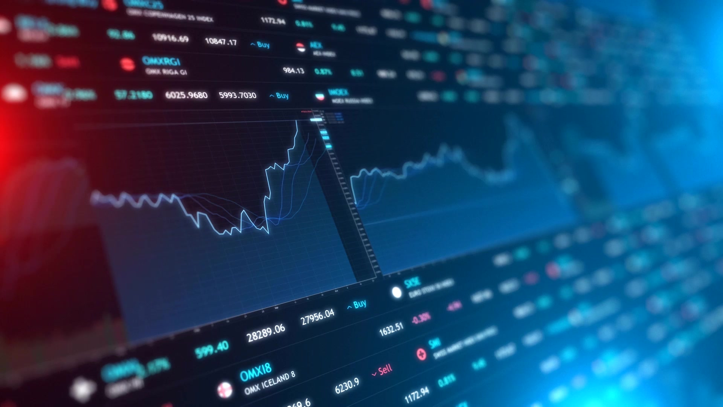
End Goal
Python Shiny Dashboard
Providing “Graphics and Predictive Modelling Services for Investors and Consumers”
Graphics and Predictive Modelling Services:
Simple ExRate Graphics (seen in past slide)
Currency Trend Predictor (ML Solution, likely LSTM)
Travel Planner (Cheapest time for Travel, e.g. Europe 2022/Japan 2024)
*Maybe* Carry Trade Screener
(Might be biting off more than I can chew)

